Slide 1

UNIT – III Introduction To C
FYBTECH
Subject : Programming and Problem Solving

Slide 2
Unit 3 Contents
Introductions to C: Fundamentals of C-Programming - Character Set, Identifiers and keywords, Data types, Constants, Variables, Operators, Expression, statements, Library Functions, Pre-processor directives. Data Input and Output, Control Structures- Decision making, Control Structures- Iterative, break and continue statements, Structure of C program, Coding conventions. Array-single, multidimensional arrays, String in C –standard string functions in string.h. Functions in C, recursion, Different parameter passing methods, Lifetime of variables, Scope rules: Static and Dynamic scope, user defined string functions, Structure, Pointers, Structure - Array of structure, Union, Pointers, Pointers and arrays, Dynamic allocation and its application, Files: Types of File, File operation, Processing File.

Slide 3
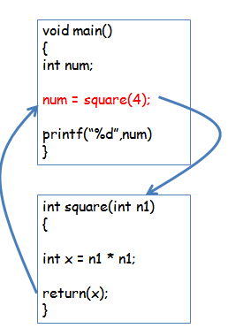
What is a Function
Function is a procedure or a routine that executes a certain task and returns a value
It is a subprogram or a set of instructions written to do a particular task
A function is a ‘self-contained’ block of statements that perform some task
A large program can be divided into functions and combined into single unit
Every C program is a collection of one or more functions

Slide 4
Types of Functions
Library Functions
They are in-built functions of ‘C’ library. These are already defined in header files.
Eg. printf(); Defined in stdio.h
strlen(); Defined in string.h
User Defined Functions
Programmer creates his own functions to perform some task
Eg. add()

Slide 5
Library functions
These functions are not required to be written by the user
They need not be declared and defined
To use library functions, add #include preprocessor directive in the program
Example:
To use mathematical functions write
#include<math.h>
To use string functions write
#include<string.h>

Slide 6
Prototype of User Defined Function
Following are the three main sections which must be used while including function
Function declaration
Function call
Function definition

Slide 7
Function Declaration
A function name preceded by its return type and followed by its parameter list is called a ‘function declaration’ or ‘function prototype’
Similar to variable declaration
If there is a need of function, it should be declared first
Syntax:
data_type function_name (argument list with data types);
here data_type is a data type of return value;
function_name is any user given name
argument list is a list of variables required in function

Slide 8
Function Declaration
Example:
int add(int a,int b);
void display();
The functions can be declared above the main() or in the main() method
If function does not return any value then void data type is used
Function returns only one value

Slide 9
Function Call
It means calling a function in a program by writing function name and passing arguments
Syntax:
function_name(list of actual argument);
Here actual arguments are the values of variables passed / given to the function definition

Slide 10
Function Call
Example:
add(a,b);
fact(6);
display();
When compiler encounters function call, the control is transferred to the function
The function is then executed line by line
A value is returned when a return statement is encountered

Slide 11
Types of Function Call
Functions communicate with each other by passing arguments.
Arguments can be passed in one of following 2 ways:
Call By Value
Call By Reference

Slide 12
Call By Value
When function is called by passing normal values or variables then function call is called as a Call by Value
In C, by default all function arguments are passed By Value.
When arguments are passed to called function, values are passed through temporary variables. All manipulations are done on these temporary variables only.
Therefore called function can not access actual memory location of original variable and so can not change its value.
Example:
add(5,10);
add(x,y);

Slide 13
Call By Reference
At the time of function call instead of passing variables or values, reference of variables (address of variables) are passed then it is called as Call by Reference
Here the called function has access to actual memory location of variable passed as an argument
Therefore can change value of arguments of calling routine
Here & (ampersand) is used before variable when it is passed as a argument in function
Example:
add(&x,&y);

Slide 14
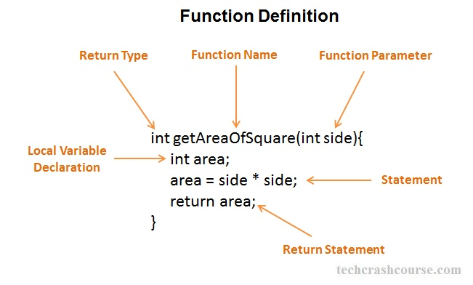
Function Definition
The function’s return type, followed by its name, parameter list, and body constitute the ‘function definition’
Function name must be same in declaration, call and definition
Each function has a unique name
‘Function body’ refers to the statements that represent the actions that the function performs

Slide 15
Function Definition
The general form of a function definition in C programming language is as follows −
Syntax:
return_type function_name( parameter list ) { body of the function }

Slide 16
Function Definition
Body of function: may consist of variable declarations and one or more executable statements
Result of a function is called as ‘return value’
The data type of the return value is called the ‘return type’
If no data type is specified, function is assumed to be void i.e. it returns no result.
A semicolon is used after function declaration and function call, but not after the function definition.
Parenthesis are compulsory after the function name, irrespective of whether the function has arguments or not

Slide 17
Function Arguments
A ‘function argument’ is an expression that is used within the parenthesis of a function call.
Arguments are separated by commas. Arguments are enclosed in a parentheses. If no arguments, a pair of empty parentheses must follow the function name.
Types of Arguments:
Actual Arguments
Formal Arguments

Slide 18
Function Arguments
Arguments in calling function are called Actual Arguments.
Called Function is: int add(int x, int y).
Arguments in called function are called Formal Arguments
Actual arguments are passed in function call and received in formal arguments at function definition
Data type of Actual and Formal arguments should be the same.
Number and order of actual arguments should also be the same as that in formal arguments.

Slide 19
Program for Addition by using Function
#include<stdio.h>
int add(int x , int y); /* Function Declaration / Prototype*/
void main() /* Calling Function*/
{
int i;
printf(“Enter two numbers : ”);
scanf(“%d%d”,&a,&b);
c=add(a,b); /*Function Call*/
printf("\n\n\tAddition of %d and %d is %d",a,b,c);
}
int add(int x,int y) /*Function Definition (Called Function)*/
{
int z;
z = x + y;
return(z);
}

Slide 20
The ‘return’ Statement
Syntax:
return(expression); OR
return(constant); OR
return;
Example:
return(c=a*b); OR return(c);
It always returns the value of the expression or variable which is written inside the parenthesis following the return statement.
When a function does not return any value, then void is used.
return statement can return only one value.

Slide 21
The ‘return’ Statement
It is used to return from a function.
It causes execution to return to the point at which the call to the function was made.
int add(int x,int y) can be written in 2 ways:
int add(int x , int y) { return(x + y); } | int add(int x , int y) { int z; z = x + y; return( z ); }

Slide 22
Recursion
The process in which a function calls itself directly or indirectly is called recursion and the corresponding function is called as recursive function.
The C programming language supports recursion, i.e., a function to call itself. But while using recursion, programmers need to be careful to define an exit condition from the function, otherwise it will go into an infinite loop.
Recursive functions are very useful to solve many mathematical problems, such as calculating the factorial of a number, generating Fibonacci series, etc.

Slide 23
Recursion Example : Fibonacci numbers
//Calculate Fibonacci numbers using recursive function.
//A very inefficient way, but illustrates recursion well
int fib(int number)
{
if (number == 0) return 0;
if (number == 1) return 1;
return (fib(number-1) + fib(number-2));
}
int main(){ // driver function
int inp_number;
printf("Please enter an integer:”);
scanf(“%d”,&inp_number);
printf("The Fibonacci number for %d is %d”, inp_number ,
fib(inp_number));
return 0;
}

Slide 24
Example contd

Slide 25
Recursion Example(Factorial)
#include<stdio.h>
int find_factorial(int);
int main() {
int num, fact; /*Ask user for the input and store it in num*/
printf("\nEnter any integer number:");
scanf("%d",&num);
/*Calling our user defined function*/
fact =find_factorial(num); /*Displaying factorial of input number */
printf("\nFactorial of %d is: %d",num, fact);
return 0;
}
int find_factorial(int n) {
/*Factorial of 0 is 1*/
if(n==0) return(1);
/*Function calling itself: recursion */
return(n*find_factorial(n-1));
}
Output:
Enter any integer number: 4
Factorial of 4 is: 24

Slide 26
Lifetime of Variables
Scope is how far a variable is accessible and life is how much time does a variable exists in the memory (life of variable).
The scope and life of a variable depends on the location where a variable is declared
According to their declaration, variables are classified into 3 categories
Block variables
Internal or Local variables
External or Global variables.

Slide 27
Block variables in C
Scope of block variables:
Block variables can be accessed within the block in which they are declared, can also be accesses into the inner block which is within the current block but, can’t be accessed outside the block.
Life of block variables:
These variables appear as the control enters into the block and disappears as the control go out of the block. Hence these variables can’t be accessed outside the block.

Slide 28
Block Variable Example
/* scope of block variables */
#include<stdio.h>
int main(){
{ /* outer block */
int x=10;
{ /* inner block */
printf("x=%d",x);
}
printf("\nx=%d",x);
}
return 0;
}
Output: x=10 x=10

Slide 29
Block Variable Example
/* scope of block variables */
#include<stdio.h>
int main()
{
if(10<20)
{
int x=10;
printf("x=%d",x);
}
printf("\nx=%d",x); /* can't be accessed */
return 0;
}
Output: Error: Undefined symbol “x” in function main()

Slide 30
Local Variables
Variables that are declared inside a function or block are called local variables.
They can be used only by statements that are inside that function or block of code.
Local variables are not known to functions outside their own.

Slide 31
Local Variables Example
#include <stdio.h>
int main () {
/* local variable declaration */
int a, b; int c;
/* actual initialization */
a = 10; b = 20;
c = a + b;
printf ("value of a = %d, b = %d and c = %d\n", a, b, c);
return 0;
}
Notes:
The following example shows how local variables are used. Here all the variables a, b, and c are local to main() function.

Slide 32
Global Variables
Global variables are defined outside a function, usually on top of the program.
Global variables hold their values throughout the lifetime of your program and they can be accessed inside any of the functions defined for the program.
A global variable is available for use throughout your entire program after its declaration.

Slide 33
Global Variables Example
#include <stdio.h>
/* global variable declaration */
int g;
int main () {
/* local variable declaration */
int a, b;
/* actual initialization */
a = 10; b = 20;
g = a + b;
printf ("value of a = %d, b = %d and g = %d\n", a, b, g);
return 0;
}

Slide 34
Scope Rules
In computer programming, a scope is the context within a computer program in which a variable name or other identifier is valid and can be used, or within which a declaration has effect.

Slide 35
Static Scoping
Static scoping is also called lexical scoping.
A variable always refers to its top level environment.
In most of the programming languages including C, C++ and Java, variables are always statically (or lexically) scoped i.e., binding of a variable can be determined by program text and is independent of the run-time function call stack.

Slide 36
Static Scoping Example
#include<stdio.h>
int x = 10;
/* Called by g()*/
int f(){
return x;
}
/* g() has its own variable*/
/* named as x and calls f()*/
int g(){
int x = 20;
return f();
}
int main()
{
printf("%d", g());
printf("\n");
return 0;
}
Output
10
Notes:
For example, output for the below program is 10, i.e., the value returned by f() is not dependent on who is calling it (Like g() calls it and has a x with value 20). f() always returns the value of global variable x.

Slide 37
Dynamic Scoping
With dynamic scope, a global identifier refers to the identifier associated with the most recent environment, and is uncommon in modern languages.
In dynamic scoping the compiler first searches the current block and then successively all the calling functions.

Slide 38
Dynamic Scoping Example
/* Since dynamic scoping is very uncommon in the familiar languages, we consider the following pseudo code as our example. It prints 20 in a language that uses dynamic scoping. */
int x = 10;
/* Called by g()*/
int f(){
return x;
}
/* g() has its own variable named as x and calls f()*/
int g(){
int x = 20;
return f();
}
main(){
printf(g());
}
Output in a language that uses Dynamic Scoping :
20
Notes:
In simpler terms, in dynamic scoping the compiler first searches the current block and then successively all the calling functions.

Slide 39
Introduction to Structures
A structure contains a number of data types grouped together.
These data types may or may not be of the same type.
The following example illustrates the use of this data type.
struct book
{
char name ;
float price ;
int pages ;
} ;
struct book b1, b2, b3 ;
This statement defines a new data type called struct book. Each variable of this data type will consist of a character variable called name, a float variable called price and an integer variable called pages.
Once the new structure data type has been defined one or more variables can be declared to be of that type.
The variables b1, b2, b3 can be declared to be of the type struct book,

Slide 40
Continue….
We can combine the declaration of the structure type and the structure variables in one statement.
struct book
{
char name ;
float price ;
int pages ;
} b1, b2, b3 ;
Like primary variables and arrays, structure variables can also be initialized where they are declared. struct book {
char name[10] ;
float price ;
int pages ;
} ;
struct book b1 = { "Basic", 130.00, 550 } ;
struct book b2 = { "Physics", 150.80, 800 } ;
Notes:
Note the following points while declaring a structure type:
The closing brace in the structure type declaration must be followed by a semicolon.
It is important to understand that a structure type declaration does not tell the compiler to reserve any space in memory.
Usually structure type declaration appears at the top of the source code file, before any variables or functions are defined.
In very large programs they are usually put in a separate header file, and the file is included (using the preprocessor directive #include) in whichever program we want to use this structure type.
In arrays we can access individual elements of an array using a subscript. Structures use a different scheme.
They use a dot (.) operator.
So to refer to pages of the structure defined in our sample program we have to use, b1.pages
Similarly, to refer to price we would use, b1.price
Note that before the dot there must always be a structure variable and after the dot there must always be a structure element.

Slide 41
How Structure Elements are Stored
Whatever be the elements of a structure, they are always stored in contiguous memory locations. The following program would illustrate this:
/* Memory map of structure elements */
main( )
{
struct book
{
char name ;
float price ;
int pages ;
} ;
struct book b1 = { 'B', 130.00, 550 } ;
printf ( "\n Address of name = %u", &b1.name ) ;
printf ( "\n Address of price = %u", &b1.price ) ;
printf ( "\n Address of pages = %u", &b1.pages ) ;
}
e.g. The output of the program... Address of name = 65518
Address of price = 65519
Address of pages = 65523

Slide 42
Nested Structures
Nesting of structures, is also permitted in C language.
Nested structures means, that one structure has another structure as member variable.
Example:
struct Student {
char[30] name;
int age;
/* here Address is a structure */
struct Address {
char[50] locality;
char[50] city;
int pincode; }
addr;
};

Slide 43
Array of Structures
If we want to store data of 100 books then we would be required to use 100 different structure variables from b1 to b100, which is definitely not very convenient.
A better approach would be to use an array of structures.
Program shows how to use an array of structures.
main( )
{
struct book
{
char name ;
float price ;
int pages ;
} ;
struct book b[100] ;
int i ;
for ( i = 0 ; i <= 99 ; i++ )
{
printf ( "\n Enter name, price and pages " ) ;
scanf ( "%c %f %d", &b[i].name, &b[i].price, &b[i].pages ) ;
}
for ( i = 0 ; i <= 99 ; i++ )
printf ( "\n %c %f %d", b[i].name, b[i].price, b[i].pages ) ;
}
Notes:
A few points about the program:
The array of structures is declared...
struct book b[100] ;
This provides space in memory for 100 structures of the type struct book.
The syntax we use to reference each element of the array b is similar to the syntax used for arrays of int’s and chars.
For example, we refer to zeroth book’s price as b[0].price.
In an array of structures, all elements of the array are stored in adjacent memory locations.

Slide 44
Introduction to Unions
Unions are derived data types, the way structures are.
Both structures and unions are used to group a number of different variables together.
But structure stored a different variables at different spaces in memory.
A union stored a different variables at same space in memory.
Syntax:
union demo{
short int i;
char ch[2];
};
union demo key;

Slide 45
Example of Unions
printf(“key.i= %d\n”, key.i);
printf(“key.ch[0]= %d\n”, key.ch[0]);
printf(“key.ch[1]= %d\n”, key.ch[1]);
key.ch[0] = 50;
printf(“key.i= %d\n”, key.i);
printf(“key.ch[0]= %d\n”, key.ch[0]);
printf(“key.ch[1]= %d\n”, key.ch[1]);
return 0;}
#include<stdio.h>
int main()
{
union a
{
short int i;
char ch[2];
};
union a key;
key.i = 512;
Output:
key.i=512
key.ch[0]=0
key.ch[1]=2
key.i=50
key.ch[0]=50
key.ch[1]=2

Slide 46
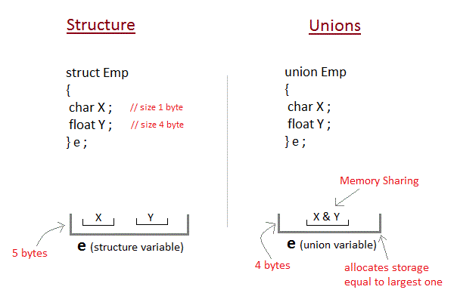
Difference Between Structure and Union

Slide 47
Enumeration (or enum) in C
Enumeration (or enum) is a user defined data type in C. It is mainly used to assign names to integral constants, the names make a program easy to read and maintain.
Example:
enum State {Working = 1, Failed = 0};

Slide 48
Enumeration (or enum) in C
Example:
enum flag{constant1, constant2, constant3, ....... };
The name of enumeration is "flag" and the constant are the values of the flag. By default, the values of the constants are as follows: constant1 = 0, constant2 = 1, constant3 = 2 and so on.

Slide 49
Enumeration
/* An example program to demonstrate working of enum in C*/
#include<stdio.h>
enum week{Mon, Tue, Wed, Thur, Fri, Sat, Sun};
int main(){
enum week day;
day = Wed;
printf("%d",day);
return 0;
}
Output: 2
/* In both of the below cases, "day" is defined as the variable of type week. */
enum week{Mon, Tue, Wed};
enum week day;
/* Or */
enum week{Mon, Tue, Wed} day;

Slide 50
Pointers
A pointer is a reference to another variable (memory location) in a program
Used to change variables inside a function (reference parameters)
Used to remember a particular member of a group (such as an array)
Used in dynamic (on-the-fly) memory allocation (especially of arrays)
Used in building complex data structures (linked lists, stacks, queues, trees, etc.)

Slide 51
Pointer Notation
Consider the declaration,
int i = 3 ;
This declaration tells the C compiler to:
(a) Reserve space in memory to hold the
integer value.
(b) Associate the name i with this memory
location.
(c) Store the value 3 at this location.
The important point is, i’s address in memory is a number.
i
Location
name
3
Value at
location
65524
Location
number

Slide 52
Declaration of Pointer Variable
General syntax of pointer declaration is
data-type *pointer_name;
Data type of a pointer must be same as the data type of a variable to which the pointer variable is pointing.
Void type pointer works with all data types, but is not used often used.

Slide 53
Initialization of Pointer Variable
Pointer Initialization is the process of assigning address of a variable to pointer variable.
Pointer variable contains address of variable of same data type.
In C language Address Operator & is used to determine the address of a variable.
The & (immediately preceding a variable name) returns the address of the variable associated with it.

Slide 54
Example
int a = 10 ;
int *ptr ; //pointer declaration
ptr = &a ; //pointer initialization
or
int *ptr = &a ; //initialization and
declaration together

Slide 55
Example(Continue)
main()
{
int i = 3;
printf (“\n Address of I = %u”, &i );
printf (“\n Value of I = %d”, i);
}
OUTPUT:
Address of i = 65524
Value of i = 3
%u, is a format specifier for printing an unsigned integer
‘&’ used in this statement is C’s ‘address of’ operator.
The expression &i returns the address of the variable i.

Slide 56
Example (Continue)
main()
{
int i = 3;
printf (“\n Address of i = %u”, &i );
printf (“\n Value of i = %d”, i);
printf (“\n Value of i = %d”, *(&i));
}
OUTPUT:
Address of i = 65524
Value of i = 3
Value of i = 3
The other pointer operator available in C is ‘*’, called ‘value at address’ operator.
It gives the value stored at a particular address.
The ‘value at address’ operator is also called ‘indirection’ operator.

Slide 57
Example (Continue)
main()
{
int i = 3;
int *j;
j = &i;
printf (“\n Address of i = %u”, &i );
printf (“\n Address of i = %u”,j );
printf (“\n Address of j = %u”, &j );
printf (“\n Value of j= %u”, j);
printf (“\n Value of i = %d”, i);
printf (“\n Value of i = %d”, *(&i));
printf (“\n Value of i = %d”, *j);
}
INPUT
OUTPUT:
Address of i = 65524
Address of i = 65524
Address of j = 65522
Value of j = 65524
Value of i = 3
Value of i = 3
Value of i = 3

Slide 58
Example (Continue)
i is an ordinary int,
j is a pointer to an int (often called an integer pointer), whereas k is a pointer to an integer pointer
main()
{
int i = 3, *j, **k;
j = &i;
k = &j;
printf (“\n 1.Address of i = %u”, &i );
printf (“\n 2.Address of i = %u”, j );
printf (“\n 3.Address of i = %u”, *k );
printf (“\n 4.Address of j = %u”, &j );
printf (“\n 5.Address of j = %u”, k );
printf (“\n 6.Address of k = %u”, &k );
printf (“\n 7.Value of j= %u”, j);
printf (“\n 8.Value of k= %u”, k);
printf (“\n 9.Value of i = %d”, i);
printf (“\n 10.Value of i = %d”, *(&i));
printf (“\n 11.Value of i = %d”, *j);
printf (“\n 12.Value of i= %d”, **k);
}
OUTPUT:
1.Address of i = 65524
2.Address of i = 65524
3.Address of i = 65524
4.Address of j = 65522
5.Address of j = 65522
6.Address of k = 65520
7.Value of j = 65524
8.Value of k = 65522
9.Value of i = 3
10.Value of i = 3
11.Value of i = 3
12.Value of i = 3

Slide 59
Pointer Arithmetic
main( )
{
int *ptr;
char *ptr1;
float *ptr2;
ptr++; ptr1++;
ptr2++;
}
A pointer in c is an address, which is a numeric value.
You can perform arithmetic operations on a pointer just as you can on a numeric value.
There are four arithmetic operators that can be used on pointers: ++, --, +, and –
Consider that ptr is an pointer variable which points to the address 1000.
(Assuming 32-bit integers), Perform the following arithmetic operation on the pointer
Output :
ptr=1004
ptr1= 1001
ptr2 = 1008

Slide 60
Pointer Arithmetic (Continue)
Consider that ptr is an pointer variable which points to the address 800. (Assuming 32-bit integers), Perform the following arithmetic operation on the pointer −
main()
{ int *ptr;
char *ptr1;
float *ptr2;
ptr- -; ptr1- - ; ptr2 - -;
}
Addition of a number to a pointer
int i =4, *j, *k;
j=&i;
j= j+1;
j= j+9;
K = j+3;
Output :
ptr=776
ptr1= 779
ptr2 = 772

Slide 61
Pointer Arithmetic (Continue)
Subtraction of a number to a pointer
int i =4, *j, *k;
j=&i;
j= j-2;
j= j - 5;
K = j - 3;
Following operations are not work out on pointers:
Additions of 2 pointers
Multiplying a pointer with a number
Dividing a pointer with a number

Slide 62
Function Call
The two types of function calls—
Call by Value
Call by Reference.
Arguments can generally be passed to functions in one of the two ways:
sending the values of the arguments
sending the addresses of the arguments

Slide 63
Call by Value Example
main()
{
int a = 10, b=20;
swapv(a,b);
printf(“\n a = %d b= %d”, a,b);
}
swapv (int x, int y)
{
int t;
t = x;
x = y;
y = t;
printf(“\n x = %d y = %d”, x,y);
}
OUTPUT:
x = 20 y = 10
a = 10 b = 20
In this method the ‘value’ of each of the actual arguments in the calling function is copied into corresponding formal arguments of the called function.
With this method the changes made to the formal arguments in the called function have no effect on the values of actual arguments in the calling function.
63

Slide 64
Call by Reference Example
main()
{
int a = 10, b=20;
swapr(&a,&b);
printf(“\n a = %d b= %d”, a,b);
}
swapr (int *x, int *y)
{
int t;
t = *x;
*x = *y;
*y = t;
printf(“\n x = %d y = %d”, *x,*y);
}
OUTPUT:
x = 20 y = 10
a = 20 b = 10
In this method (call by reference) the addresses of actual arguments in the calling function are copied into formal arguments of the called function.
This means that using these addresses we would have an access to the actual arguments and hence we would be able to manipulate them
64

Slide 65
Dynamic Memory Allocation
Dynamic memory allocation is used to obtain and release memory during program execution
Up until this point we reserved memory at compile time using declarations
To use the functions discussed here, you must include the stdlib.h header file.
Four Dynamic Memory Allocation Functions:
Allocate memory - malloc(), calloc(), and realloc()
Free memory - free()

Slide 66
malloc()
To allocate memory use
void *malloc(size_t size);
Takes number of bytes to allocate as argument
Use sizeof to determine the size of a type
Returns pointer of type void *. A void pointer may be assigned to any pointer
If no memory available, returns NULL
e.g.
char *line;
int linelength = 100;
line = (char*)malloc(linelength);

Slide 67
malloc() Example
To allocate space for 100 integers:
int *ip;
if ((ip = (int*)malloc(100 * sizeof(int))) == NULL){
printf("out of memory\n");
exit();
}
Note we cast the return value to int*.
Note we also check if the function returns NULL.

Slide 68
Allocating memory for a struct
You can also allocate memory for a struct.
Example:
struct node *newPtr;
newPtr = (struct node *)malloc(sizeof(struct node));
Memory allocated with malloc() lasts as long as you want it to.
It does not automatically disappear when a function returns, as automatic-duration variables do, but it does not have to remain for the entire duration of your program, either. There is a mechanism to free allocated memory.

Slide 69
free()
To release allocated memory use
free()
Deallocates memory allocated by malloc()
Takes a pointer as an argument
e.g.
free(newPtr);
Freeing unused memory is a good idea, but it's not mandatory
When your program exits, any memory which it has allocated but not freed will be automatically released

Slide 70
calloc()
Similar to malloc(), the main difference is that the values stored in the allocated memory space are zero by default. With malloc(), the allocated memory could have any value.
calloc() requires two arguments - the number of variables you'd like to allocate memory for and the size of each variable.
void *calloc(size_t nitem, size_t size);
Like malloc(), calloc() will return a void pointer if the memory allocation was successful, else it'll return a NULL pointer.

Slide 71
calloc() Example
/* Using calloc() to initialize 100 floats to 0.0 */
#include <stdlib.h>
#include <stdio.h>
#define BUFFER_SIZE 100
int main(){
float * buffer;
int i;
if ((buffer = (float*)calloc(BUFFER_SIZE, sizeof(float))) == NULL){
printf("out of memory\n");
exit(1);
}
for (i=0; i < BUFFER_SIZE; i++)
printf(“buffer[%d] = %f\n”, i, buffer[i]);
return 0;}

Slide 72
realloc()
If you find you did not allocate enough space use realloc().
You give realloc() a pointer (such as you received from an initial call to malloc()) and a new size, and realloc does what it can to give you a block of memory big enough to hold the new size.
int *ip;
ip = (int*)malloc(100 * sizeof(int));
...
/* need twice as much space */
ip = (int*)realloc(ip, 200 * sizeof(int));

Slide 73
What is a File ?
A file is a collection of related data that a computers treats as a single unit.
Computers store files to secondary storage so that the contents of files remain intact when a computer shuts down.
When a computer reads a file, it copies the file from the storage device to memory; when it writes to a file, it transfers data from memory to the storage device.
C uses a structure called FILE (defined in stdio.h) to store the attributes of a file.

Slide 74
Steps in Processing a File
Create the stream via a pointer variable using the FILE structure: FILE *p;
Open the file, associating the stream name with the file name.
Read or write the data.
Close the file.

Slide 75
The Basic File Operations
fopen - open a file- specify how its opened (read/write) and type (binary/text)
fclose - close an opened file
fread - read from a file
fwrite - write to a file
fseek/fsetpos - move a file pointer to somewhere in a file
ftell/fgetpos - tell you where the file pointer is located

Slide 76
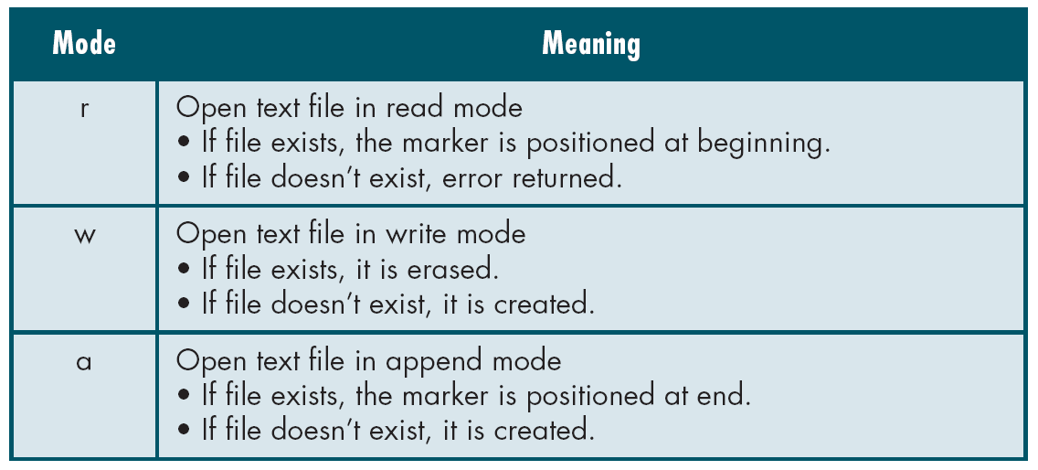
File Open Modes
File Open Modes

Slide 77
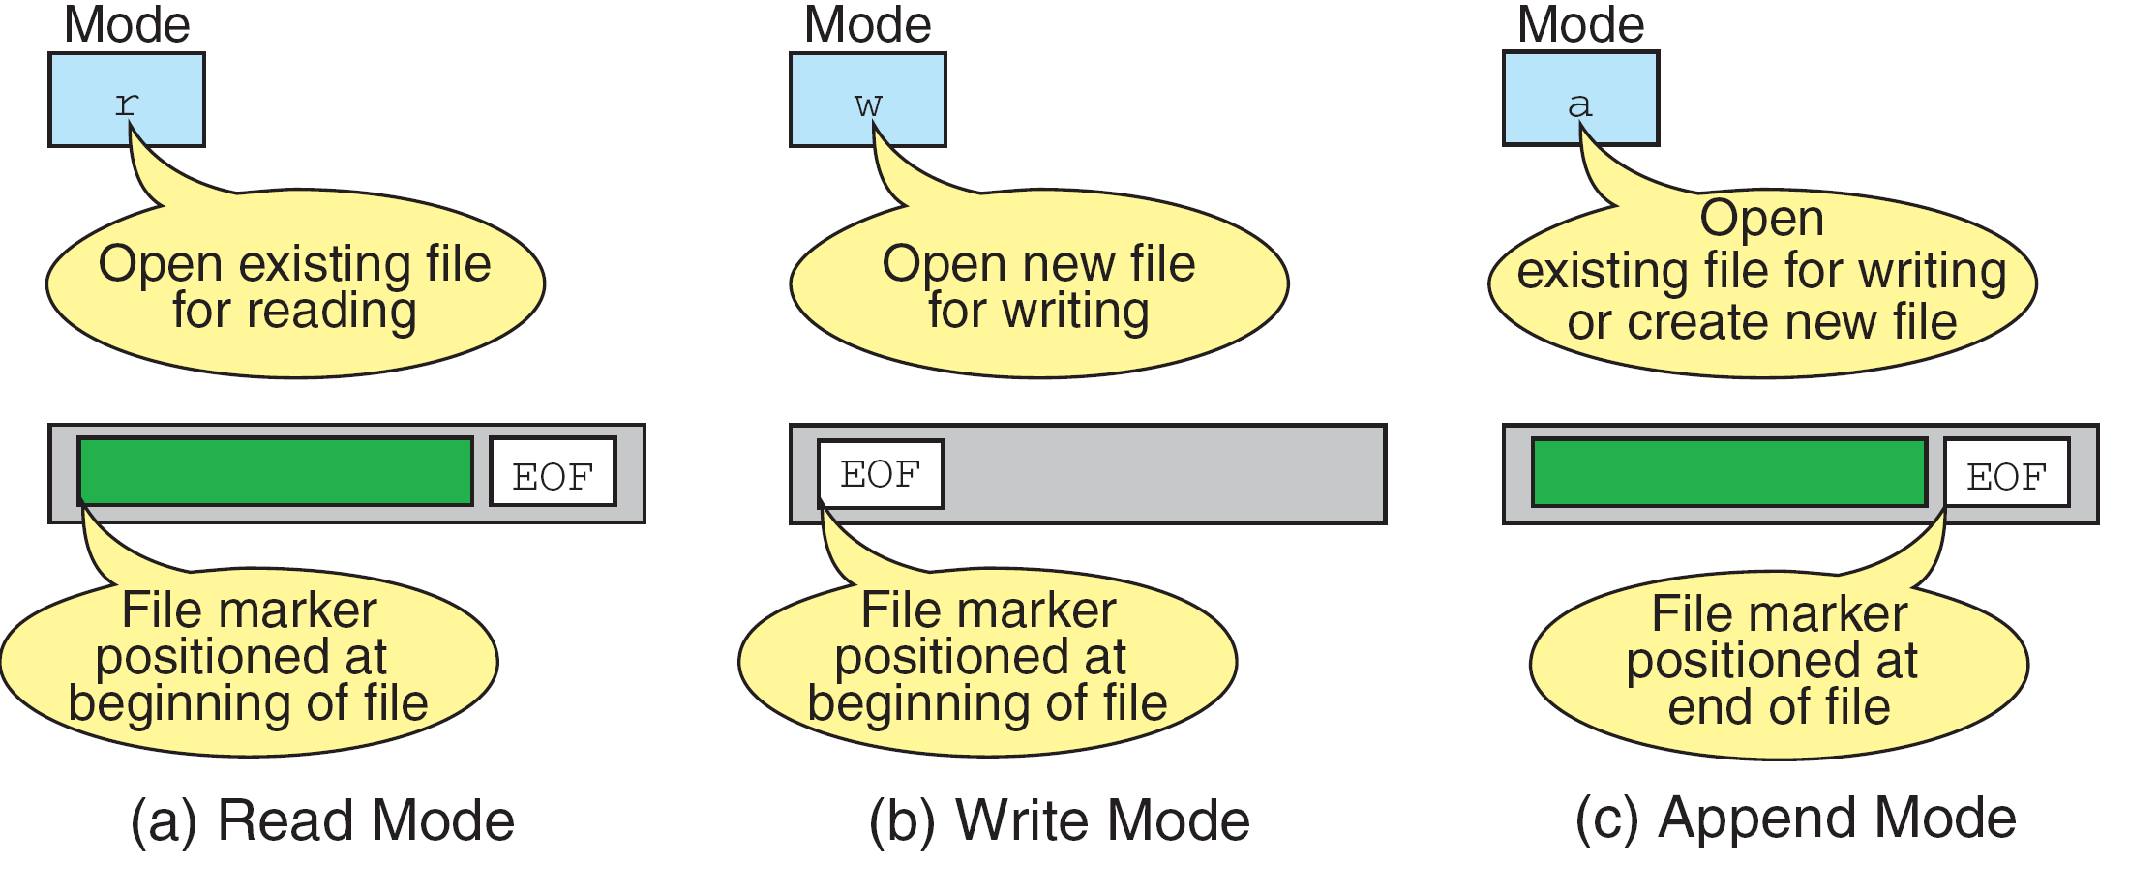
More on File Open Modes
File Open Modes

Slide 78
More on File Open Modes (Cont.)
r+ : open for reading and writing, start at beginning
w+ : open for reading and writing (overwrite file)
a+ : open for reading and writing (append if file exists)

Slide 79
File Open
The file open function (fopen) serves two purposes:
It makes the connection between the physical file and the stream.
It creates “a program file structure to store the information” C needs to process the file.
Syntax: filepointer=fopen(“filename”, “mode”);)

Slide 80
More on fopen
The file mode tells C how the program will use the file.
The filename indicates the system name and location for the file.
We assign the return value of fopen to our pointer variable:
spData = fopen(“MYFILE.TXT”, “w”);

Slide 81
More on fopen
from Figure 7-3 in Forouzan & Gilberg, p. 399

Slide 82
Closing a File
When we finish with a mode, we need to close the file before ending the program or beginning another mode with that same file.
To close a file, we use fclose and the pointer variable:
fclose(spData);

Slide 83
fprintf()
Syntax:
fprintf (fp,"string",variables);
Example:
int i = 12;
float x = 2.356;
char ch = 's';
FILE *fp;
fp=fopen(“out.txt”,”w”);
fprintf (fp, "%d %f %c", i, x, ch);

Slide 84
fscanf()
Syntax:
fscanf (fp,"string",identifiers);
Example:
FILE *fp;
Fp=fopen(“input.txt”,”r”);
int i;
fscanf (fp,“%d",i);

Slide 85
getc()
Syntax:
identifier = getc (file pointer);
Example:
FILE *fp;
fp=fopen(“input.txt”,”r”);
char ch;
ch = getc (fp);

Slide 86
putc()
Write a single character to the output file, pointed to by fp.
Example:
FILE *fp;
char ch;
putc (ch,fp);

Slide 87
fread ()
Declaration:
size_t fread(void *ptr, size_t size, size_t n, FILE *stream);
Remarks:
fread reads a specified number of equal-sized data items from an input stream into a block.
ptr = Points to a block into which data is read
size = Length of each item read, in bytes
n = Number of items read
stream = file pointer

Slide 88
Example
Example:
#include <stdio.h>
int main()
{
FILE *f;
char buffer[11];
if (f = fopen("fred.txt", “r”))
{
fread(buffer, 1, 10, f);
buffer[10] = 0;
fclose(f);
printf("first 10 characters of the file:\n%s\n", buffer);
}
return 0; }

Slide 89
fwrite()
Declaration:
size_t fwrite(const void *ptr, size_t size, size_t n, FILE*stream);
Remarks:
fwrite appends a specified number of equal-sized data items to an output file.
ptr = Pointer to any object; the data written begins at ptr
size = Length of each item of data
n =Number of data items to be appended
stream = file pointer

Slide 90
Example
#include <stdio.h>
int main()
{
char a[10]={'1','2','3','4','5','6','7','8','9','a'};
FILE *fs;
fs=fopen("Project.txt","w");
fwrite(a,1,10,fs);
fclose(fs);
return 0;
}

Slide 91
fseek()
This function sets the file position indicator for the stream pointed to by stream or you can say it seeks a specified place within a file and modify it.
SEEK_SET Seeks from beginning of file
SEEK_CUR Seeks from current position
SEEK_END Seeks from end of file
Example:
#include <stdio.h>
int main()
{ FILE * f; f = fopen("myfile.txt", "w"); fputs("Hello World", f); fseek(f, 6, SEEK_SET); SEEK_CUR, SEEK_END fputs(" India", f); fclose(f); return 0; }

Slide 92
End of File
There are a number of ways to test for the end-of-file condition. Another way is to use the value returned by the fscanf function:
FILE *fptr1;
int istatus ;
istatus = fscanf (fptr1, "%d", &var) ;
if ( istatus == feof(fptr1) )
{
printf ("End-of-file encountered.\n”) ;
}

